Slide 1

Renting Valuable Stuff
Group Members-
Nayamet Ullah (19-39295-1)
S. M. Nahid (19-39998-1)
MD. Jahidul Islam Noor (19-39306-1)
Shakrin Jahan Mozumder (19-39886-1)

Slide 2
Outlines
Idea generation
Use Case diagram
Mock Design
Activity diagram
Class diagram
JIRA
GIT
Schedule
Estimation
Conclusion

Slide 3

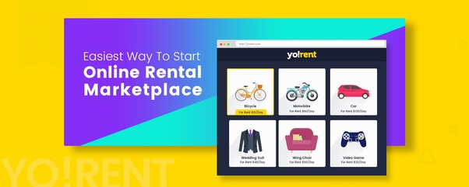
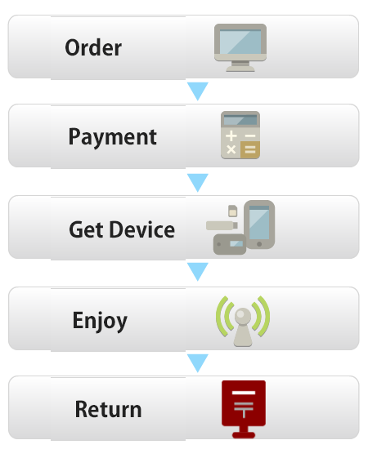
IDEA GENERATION
We don’t always get any necessary thing that we need for a limited time
Our main objective is to create a Software which will help to lessen this problem
To solve this kind of problem we have decided to take steps and add it to our problem domain

Slide 4
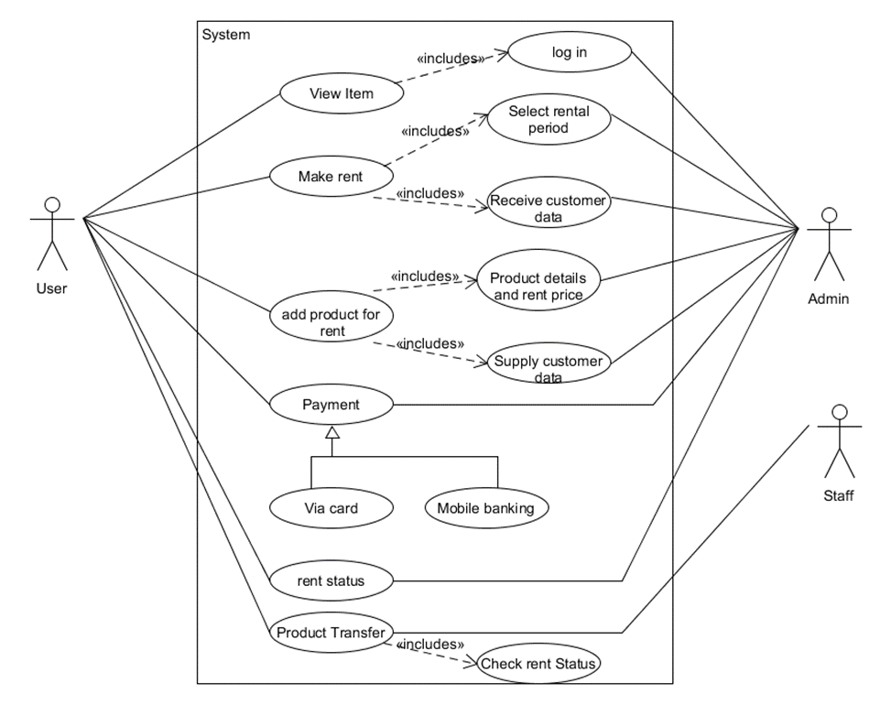
UML USE-CASE DIAGRAM
A use case is a written description of how users will perform tasks on your website
easily understandable
help to capture the functional requirements
can serve as the basis for the estimating, scheduling, and validating effort
It is traceable

Slide 5
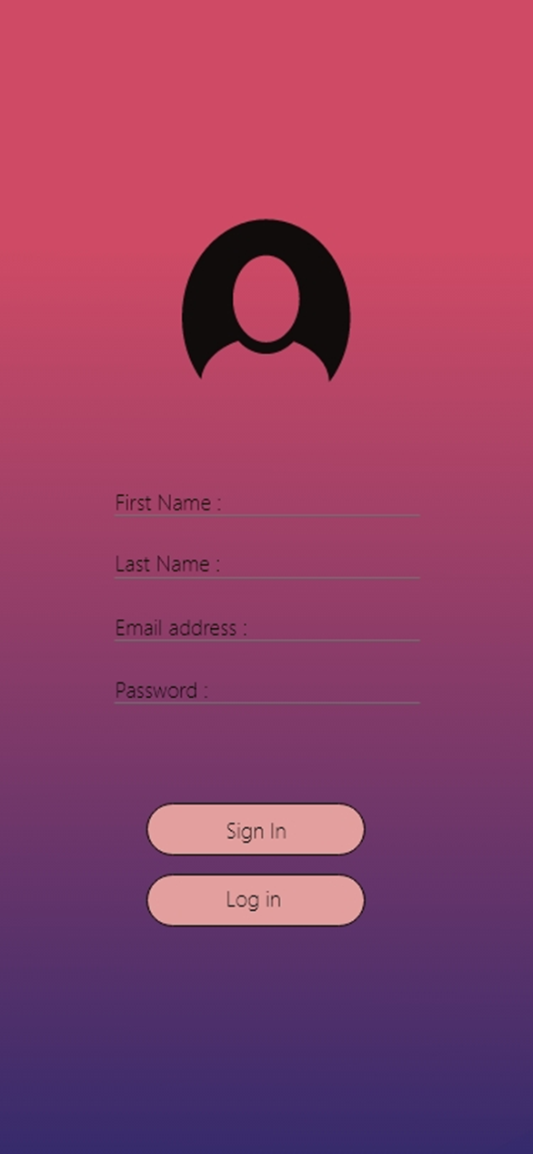
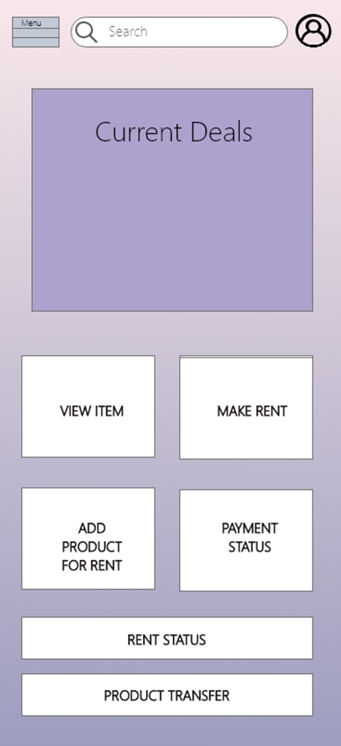
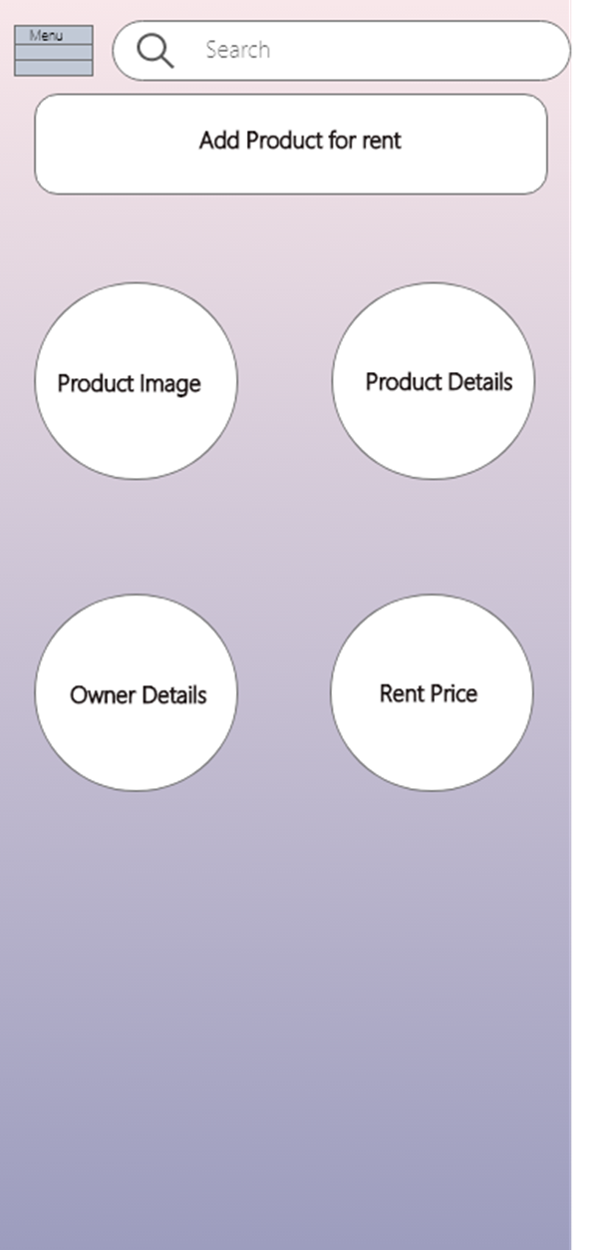
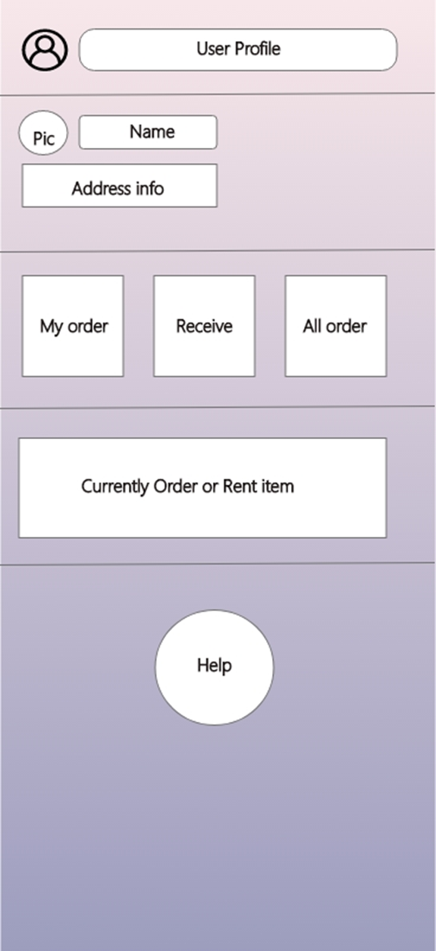
Mock Design
static picture of a web design
focusing on the overall appearance
architecture and functionality
acquire feedback from users
discussion medium between designer and user
helps improve a web design's appearance

Slide 6
ACTIVITY DIAGRAM
very similar to a flowchart
Illustrate a workflow between users and the system
describe the steps performed in a UML use case
sequential and concurrent activities
Simplify and improve any process by clarifying complicated use cases

Slide 7
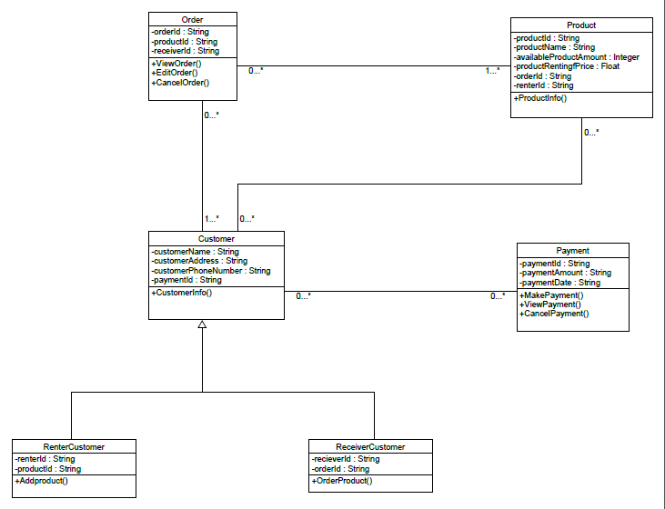
CLASS Diagram
Represent classes
There component parts.
The way in which classes of objects are related to one another.
Visibility of attributes.

Slide 8
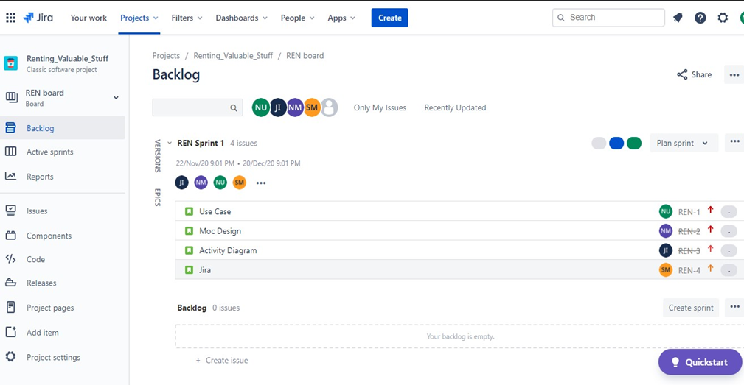
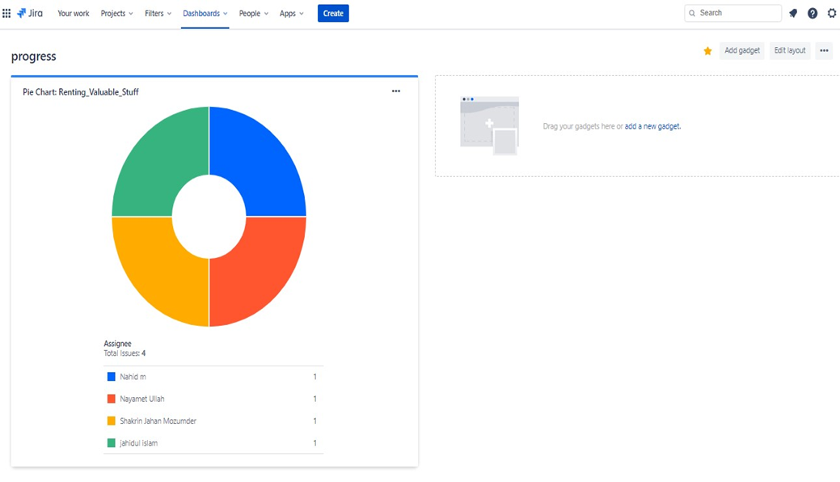
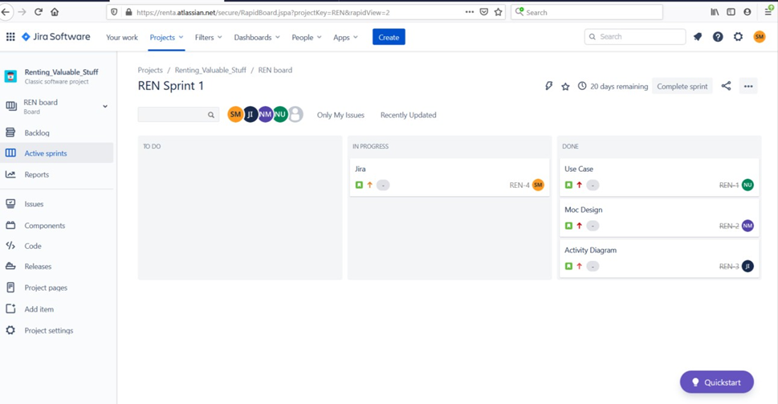
JIRA
built for planning, tracking and releasing great software
Create user issues, plan sprints, and distribute tasks
Prioritize and discuss team’s work
Improve overall team performance

Slide 9
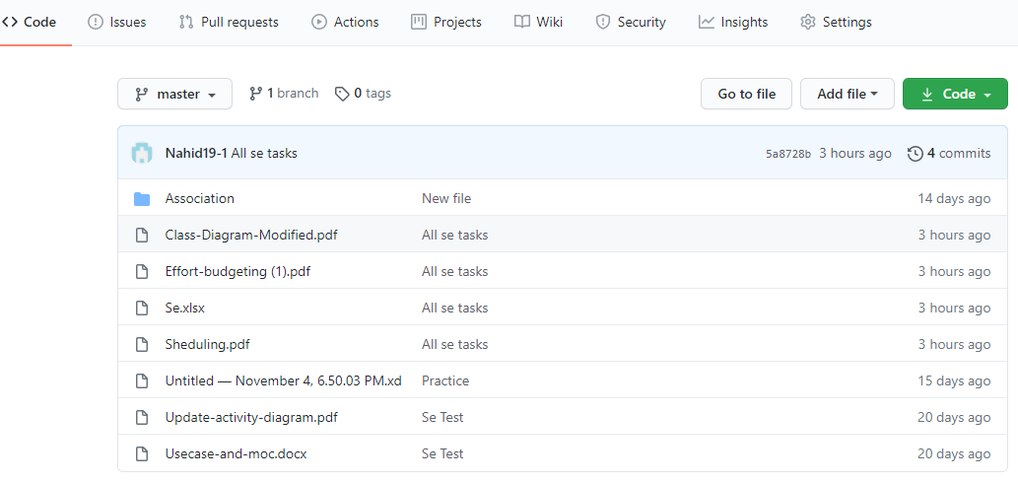
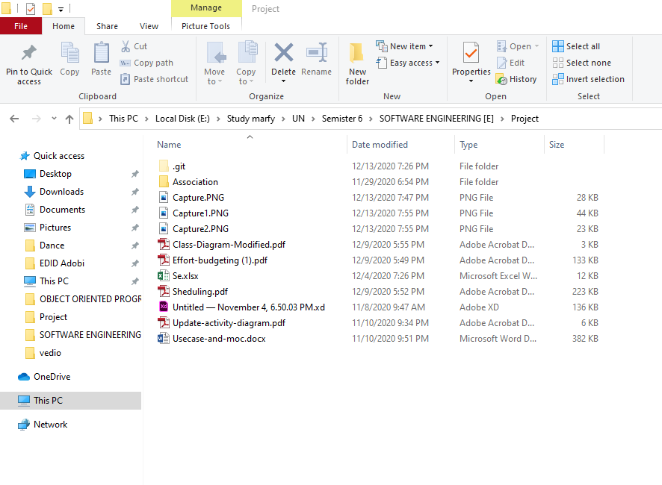
GIT
Free and open source distributed version control system
designed to handle everything from small to very large projects
ensure there are no code conflicts between the developers
tracks the changes made to files
allowing changes by multiple people to all be merged into one source

Slide 10
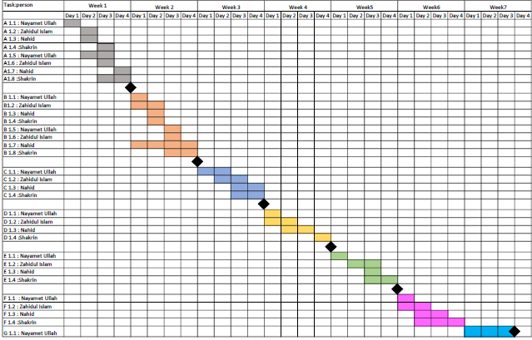
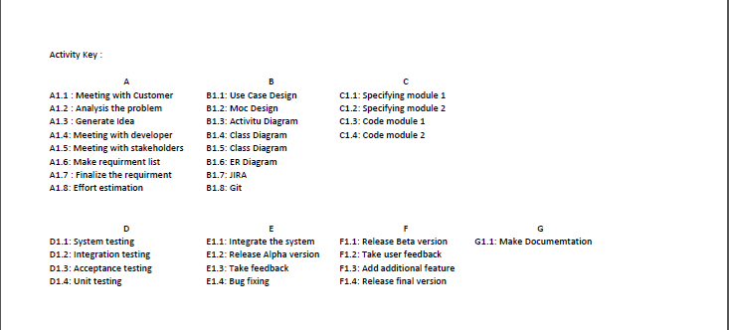
SCHEDULING
List of activities , milestones within a project
Also include start and finish date, duration and resources assign to each activity.

Slide 11
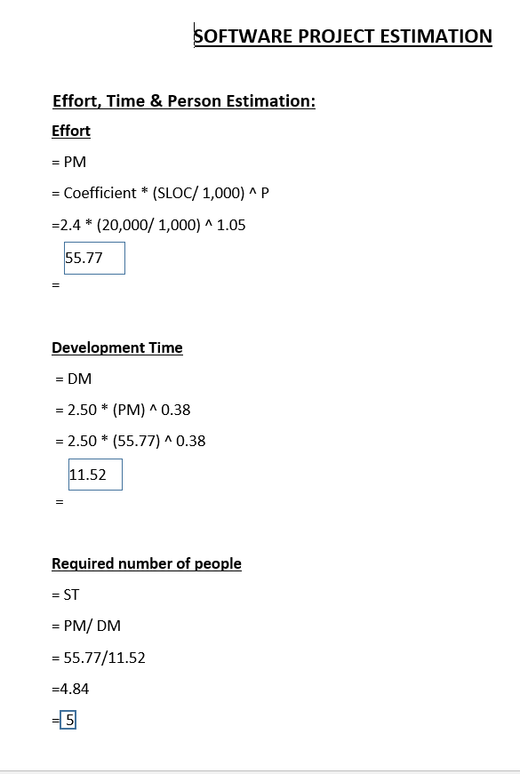
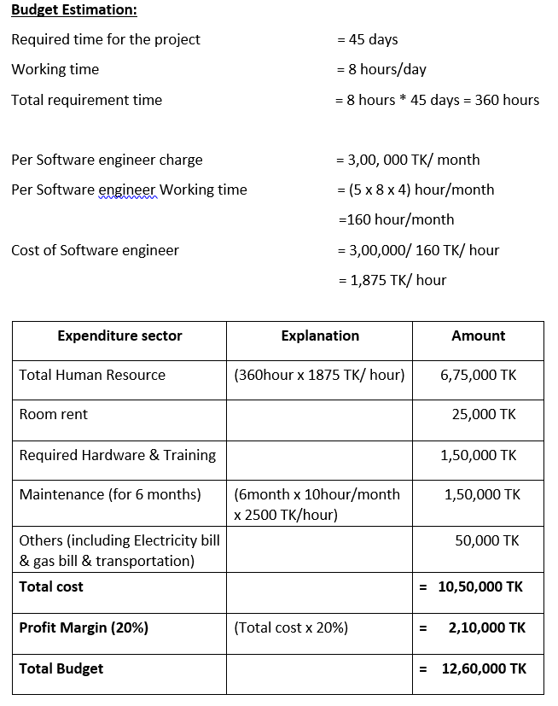
ESTIMATION
predict the time, required people & the cost requires to finish a project appropriately
Large projects are advisable to employ this crucial step to avoid unpredictable failure
The right estimation means glitch free, uninterrupted project execution
completed faster and better
best way to inspire confidence is show correct, reliable estimations

Slide 12
Conclusion
Root Causes
Time Saving
Cost Effective
Consideration
Money Saving
Recycling
Time Management
Easy Access

